Slide 1
Speculative Analysis of IDE Recommendations
Kıvanç Muşlu, Yuriy Brun, Reid Holmes,
Michael D. Ernst, and David Notkin
University of Washington
University of Massachusetts Amherst
University of Waterloo
Notes:
Hi everyone, I am Kivanc from University of Washington and today I will talk about an interesting technique that increases developer productivity when using IDE Recommendations. This is a joint work with …
General comments:
Ivan 1: Pause from time to time to increase understanding.

Slide 2
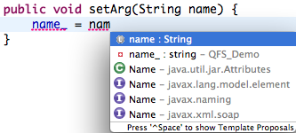
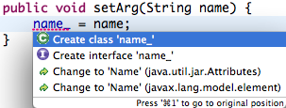
IDE Recommendations
aim to increase developer speed & confidence
are widely used by developers [Murphy et al. 2006]
Notes:
Let’s start with the IDE recommendations. In this example, we have … (Instead of telling where they are, just point them)
IDE recommendations are nice because they automate …
Mention here upfront that you will be focusing on Quick Fix for the remaining part of the talk.
Gail Murphy (et al.)
Mike: Not ‘The good part is’, just say it.

Slide 3
Making recommendations more useful
Present
IDE generates the recommendations
Developer selects a recommendation based on experience
Today
IDE generates recommendations & computes their consequences
Developer selects a better recommendation faster
Notes:
Transition incoming: Let’s look at the current workflow for using recommendations and see if we can improve them.
It is still the developer’s responsibility to evaluate the effect of applying a recommendation to the program, which is burdensome and error prone. So, let’s use the idle computing power we have to remove this burden.
Transition outgoing: Now let me show you, on a simple example, how computing the consequences of recommendations can be a burden to the developer.

Slide 4
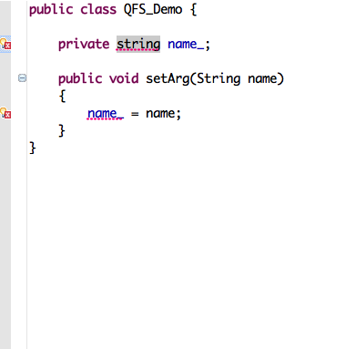
1 Logical Problem but 2 Errors
Logical Problem
Compilation error 1
Compilation error 2
Notes:
Mike: First say what the logical problem is then mention about compilation errors.
Say up front that instant feedback is important (i.e., squigglies) and cannot be given for the recommendations. QF and auto-complete are also instant feedbacks, however they might be broken (as I will show in the future) and we want to take this forward by giving also the consequences of each recommendation as instant feedback.
I want to show you the problem with IDE recommendations on a simple example.
In this example, we can see that there are two compilation errors represented by red squigglies and markers. We see this information thanks to a technology called instant compilation. In the background, Eclipse continuously tries to build our program and whenever there are compilation errors, it shows them to us. This is very helpful to the developer as he can immediately realize that he introduced an error and starts to fix it.
I am a developer and I have the following simple code. I realize that the method ‘setArg’ is named incorrectly and I decide to change its name to ‘setName’ to make changes consistently all over the code, I decide to apply a rename refactoring. For this example, I am writing in Java and using Eclipse. So Eclipse suggest me to use its refactoring engine.
I say okay, and try to apply a rename refactoring, however …

Slide 5
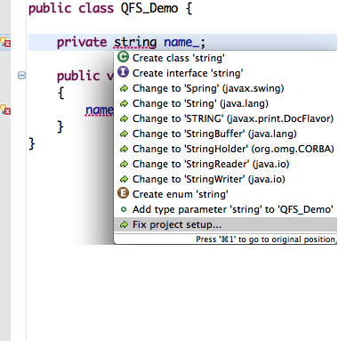
Proposals at declaration can be prioritized better
Notes:
This time the following proposals are given. I start reading them [read some]. If I am patient enough, I find the correct fix as the 4th proposal and select it.

Slide 6
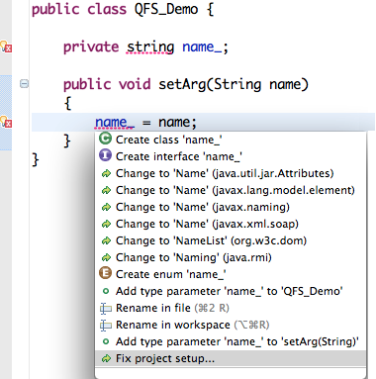
Proposals at assignment do not help
Notes:
Mike: Too Much post-explanation on why it is not good. Be briefer.
I go to the compilation error inside the method and invoke Quick Fix, Eclipse gives me the following suggestions (also known as proposals). In theory, each of these suggestions should resolve the compilation error on that line, however [read some of them] as you can see, none of them actually resolves anything.
This is due to the fact that this compilation error is dependent on the other compilation error and I should be resolving the other error, which resolves this one, too.
After spending some time, trying to understand what each proposal does, I give up and decide to invoke QF on the other compilation error.

Slide 7
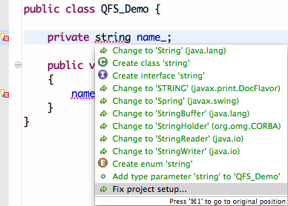
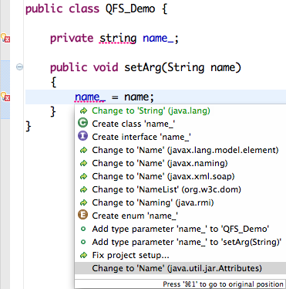
Ultimate Goal
Best fix
Best fix from any location

Slide 8
Consequences of IDE Recommendations
Problem: IDEs do not show the consequences of each recommendation
Solution: Computing and showing the consequences can increase developer productivity
Notes:
Throughout the example, I have shown you that IDEs provide little or …
However IDEs cannot give the same instant feedback for the recommendations they provide yet since the developer haven’t chosen them yet. It is still the developer’s responsibility to figure out the consequences (i.e., outcomes) of applying a refactoring or a proposal. And in general, this is not as easy as seen in this example.
For the remaining of the talk, I will be talking about a technique called speculative analysis that aims to remove this burden. My talk will specifically focus on an implementation of a speculative analysis on Eclipse Quick Fix to provide almost instant feedback about the consequences of Quick Fix proposals.

Slide 9
Outline
Motivation
Quick Fix Scout (Speculative Analysis)
Demo
Evaluation
Related Work
Contributions

Slide 10
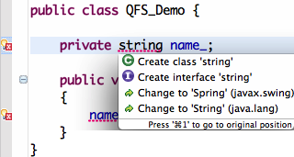
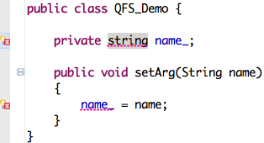
Running Speculative Analysis
Notes:
Now, I’d like to show you how speculative analysis computes remaining compilation errors. In this example, I will focus on the top four proposals. To apply them, I need 4 copies of the same code.
Mike: Focus to => Focus on.

Slide 11
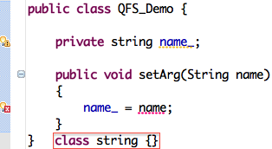
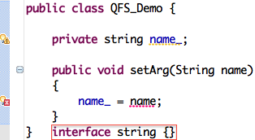
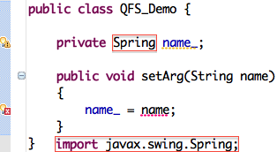
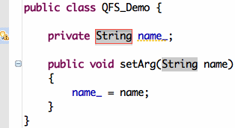
Running Speculative Analysis
1
1
1
0
Notes:
First proposal is “Create class ‘string’’. We apply that and see that only the first compilation error is fixed, so remaining number of compilation errors is 1.
Second and third proposals similarly only fix the first compilation error and still leave 1 compilation error in the project.
However, the fourth proposal “Changing ‘string’ to ‘String’” resolves all compilation errors.

Slide 12
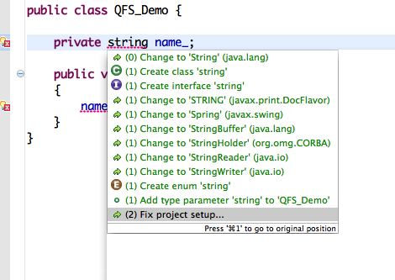
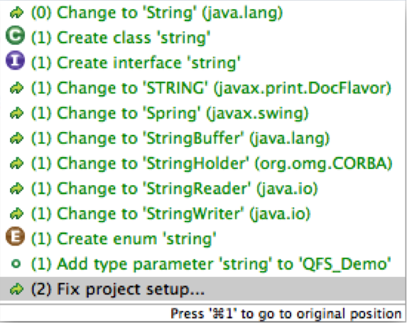
Augmented Dialog with Speculative Compilation Error Counts
Notes:
We basically do the same computation for all proposals and as a result, we have the following dialog.
There are three additions with this dialog:
1- The number of remaining compilation errors.
2- The proposals are reordered according to …
3- The proposals are colored accordingly … (don’t mention about the different colors and their meanings)

Slide 13
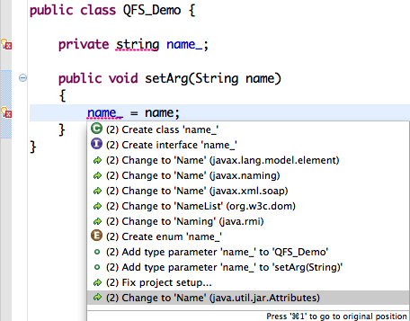
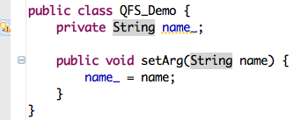
Making Quick Fix Global
0
Notes:
What about the other QF invocation? In this example none of the proposals offered by Eclipse was resolving any compilation errors. However, speculative analysis is global; we calculate the remaining compilation errors for all compilation errors and proposals on the project. Remember that we had a proposal offered for the first compilation error that resolved both errors. So, what not extract that proposal and offer it also for the second compilation error?
QFS seems nice however, remember the second compilation error. Here, none of the proposals were resolving any of the errors in the project. So, even if we compute the remaining compilation errors, it wouldn’t help much.
However, luckily the speculative analysis is global and from the first compilation error [click], we already know a proposal that could resolve the error in the second location.
So, why not just offer this proposal also for this QF?
Mike: Not ‘Answer seems to be yes’

Slide 14
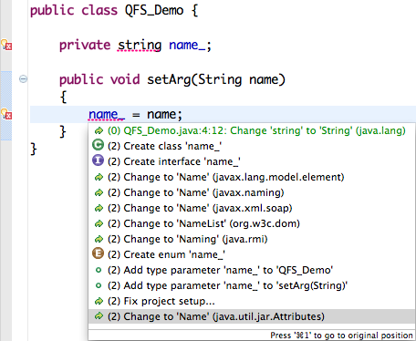
Global Best Proposal
Notes:
Now, I'd like to demo our tool.
[Eclipse opens with the first class (ExceptionalClass)]
Here is another project with one logical problem and two compilation errors. During the demo, I will always be using QFS so that we can see how the augmented dialog helps the developer.
Let's start with the first file. Method 'exceptionalMethod' has a compilation error because it throws an exception, however it does not declare this in its method signature.
[Switches to the second file (SafeClass)]
The second file has another compilation error because the code catches an exception that is never thrown in the 'try' body. If we look closely however, we realize that the try body calls 'exceptionalMethod', which throws the exception but forgot to declare it. In other words, if I were to go to the previous error location and add a throws declaration to 'exceptionalMethod', all the compilation errors would be resolved. So, my logical problem is the fact that I have a method that throws an exception but forgets to declare it.
Now, let's see what happens when I use QFS to resolve these compilation errors.
[Switches back to the first file]
I will start with the simple one, where the logical problem and the compilation error are at the same location. When I invoke quick fix [invokes quick fix], QFS prioritizes 'add throws declaration' in the list as it resolves both compilation errors.
Now let's look at the difficult one [switches to the second file]. When I invoke quick fix, I see that at the top of the dialog, QFS added a global best proposal for me, extracted from the declaration of 'exceptionalMethod'. 'add throws declaration' resolves all compilation errors in the program, however it would not normally be offered by Eclipse for this location. I can also see that the normal Eclipse proposals at locations '2' and '3' leave one compilation error left, so probably not the best selection for this error.
I will go on and invoke the global best proposal here. When I double click on it, QFS goes to the related error location and invokes the correct proposal for me and all errors in the program are fixed.
This idea leads global best proposals. In this example, you can see that QFS dialog also offers the extra proposal I have just mentioned at the top of the list.
We provide all the information that the developer needs about the remote location.
Merge with the following slide.
For GBPs, we provide two more information:
1- The context that will be modified by the proposal.
2- The actual location that proposal is offered.

Slide 15
Evaluation
Controlled experiment of Quick Fix Scout
20 grad students
Case study with 13 participants on how developers use Quick Fix
Details presented in the paper
Notes:
For evaluation we have done two studies: a case study with 6 participants (where 3 of them were also the authors) and a controlled experiment with 20 grad students.
Why you did this? Why I have two studies.

Slide 16
Controlled Experiment
RQ1: Does QFS speed up fixing compilation RQ1: RQ1: errors?
RQ2: Does QFS change developer behavior?
24 project snapshots with compilation errors
Chosen randomly from the case study participants’ development history
Mutation compilation errors were added to half of the tasks
Within-participant mixed design, 2 factors: tool & ordering
Notes:
We wanted to see if the developers can resolve compilation errors faster or better with QFS. So we created 24 projects with compilation errors and broke them into two groups: alpha and beta.

Slide 17
Controlled Experiment Results
Proposal Selection
Best Proposal selected 87% with QFS, 73% without it
Global Best Proposal selected 75% when offered
Bug Removal Time
Better by 12% (3 minutes)
Quick Fix Dialog Invocations
Users spent 0.8 seconds (22%) more examining QFS dialogs
➦ Without QFS users needed more manual exploration
➦ QFS provides users more relevant information

Slide 18
Participant Quotations
“I could tell [Quick Fix Scout] wasn’t just saving me time, but increasing my understanding of the program.”
“Where can I use [Quick Fix Scout] in my own Eclipse?…Debugging with [Quick Fix Scout] felt much faster and less stressful.”
Notes:
I’d like to conclude the evaluation section with two user quotes.
Do not call this conclusions. You can skip this if required.

Slide 19
Related Work
Improving existing recommendations
Historical information & heuristics [Robbes et al. 2008] [Bruch et al. 2009]
QFS computes consequences precisely
Defining new recommendations [Castro-Herrera et al. 2009] [Xiang et al. 2008]
Using extra type information to chain API calls [Perelman et al. 2012]
QFS analyzes existing recommendations QFS can exploit these new recommendations
Notes:
Mike: Daniel’s work belongs to new recommendations?
The first research related to QFS is defining new recommendations Speculative analysis and QFS does not care what a recommendation does as long as it will create a new program that can be analyzed. Thus, QFS is orthogonal to the new recommendations, specifically Quick Fixes meaning that it will start using them in the analysis without any modification.
The second related research is improving existing recommendations. For this, Robbes made a simulation experiment over a real development history using 8 different code-completion techniques and showed that code completion based on historical usage works the best. Later Bruch applied a similar technique to Eclipse auto-complete where he showed that auto-complete can be improved using historical data and data mining.
QFS is different from these methods because these methods improve recommendations based on some heuristics whereas we try to improve recommendations by providing consequences of the recommendations based on precise information.
For improving existing recommendations, Daniel also showed that IntelliSense’s auto complete can be improved by using partial types to find API call chains. QFS is different from this work in the sense that it does not create new recommendations but only analyzes the existing recommendations and gives more information with them.
Finally, QFS is built on speculative analysis, the idea to explore possible future states of a program to give developer more information, which was introduced by Yuriy on 2010. In the same year, Yuriy also built Crystal, a proactive conflict detection tool and the next year, he showed that speculative analysis can be used to increase developer awareness and reduce merge conflicts (or at least their severity) for collaborative development.
QFS is different because obviously it is an application of speculative analysis on another domain, however also because due to the way recommendations are used as an ad-hoc basis, it requires fine-grained speculative analysis.
I need a clear text (written and memorized) for this section.

Slide 20
Contributions
Speculation for IDE recommendations
Implementation: Quick Fix Scout http://quick-fix-scout.googlecode.com
Preliminary evidence of usefulness
Notes:
Mike: Cut intro sentence: ‘I will conclude with contributions’, just go right to the content.
Mike: Be brief answering questions.
Mike: If a question is related to a slide, go to that slide when answering it.
Some end of talk questions:
Ivan1: Is this just relevant to Eclipse?
Ivan2: Why do people have a bias/preference for certain choices?
Ivan3: What about tests? Compilation is not everything.
Unknown1: What are the performance implications?
Mike1: Is QF used rarely (related to 1000 invocations over 1 year for 13 participants)? If so, shall we care?

Slide 21
References
M. Bruch, M. Monperrus, and M. Mezini. Learning from examples to improve code completion systems. In Proceedings of the the 7th joint meeting of the European software engineering conference and the ACM SIGSOFT symposium on The foundations of software engineering, pages 213–222, Amsterdam, The Netherlands, 2009. doi: 10.1145/1595696.1595728.
Y. Brun, R. Holmes, M. D. Ernst, and D. Notkin. Speculative analysis: Exploring future states of software. In Proceedings of the 2010 Foundations of Software Engineering Working Conference on the Future of Software Engineering Research (FoSER10), Santa Fe, NM, USA, November 2010.
Y. Brun, R. Holmes, M. D. Ernst, and D. Notkin. Crystal: Proactive conflict detector for distributed version control. http://crystalvc.googlecode.com, 2010.
Y. Brun, R. Holmes, M. D. Ernst, and D. Notkin. Proactive detection of collaboration conflicts. In Proceedings of the 8th Joint Meeting of the European Software Engineering Conference and ACM SIGSOFT Symposium on the Foundations of Software Engineering (ESEC/FSE11), pages 168–178, Szeged, Hungary, September 2011. doi: 10.1145/ 2025113.2025139.

Slide 22
C. Castro-Herrera, C. Duan, J. Cleland-Huang, and B. Mobasher. A recommender system for requirements elicitation in large-scale software projects. In Proceedings of the 2009 ACM symposium on Applied Computing, SAC ’09, pages 1419–1426, 2009. doi: 10.1145/1529282.1529601.
K. Muşlu, Y. Brun, R. Holmes, M. D. Ernst, and D. Notkin. Improving IDE Recommendations by Considering Global Implications of Existing Recommendations. In Proceedings of the 34th International Conference on Software Engineering, New Ideas and Emerging Results Track, ICSE ’12, Zurich, Switzerland, June 2012.
G. C. Murphy, M. Kersten, and L. Findlater. How are java software developers using the eclipse ide? IEEE Software, 23 (4):76–83, July 2006. doi: 10.1109/MS.2006.105.
P. F. Xiang, A. T. T. Ying, P. Cheng, Y. B. Dang, K. Ehrlich, M. E. Helander, P. M. Matchen, A. Empere, P. L. Tarr, C. Williams, and S. X. Yang. Ensemble: a recommendation tool for promoting communication in software teams. In Proceedings of the 2008 international workshop on Recommendation systems for software engineering, RSSE ’08, pages 2:1–2:1, 2008. doi: 10.1145/1454247.1454259.

Slide 23
Towards fine-grained speculation
QFS always maintains a copy project that is in sync with the original one
The speculative analysis starts as soon as a change in compilation errors is detected
QFS caches the compilation errors
QFS caches proposals
QFS is aware of the active file and cursor location, the compilation errors are prioritized accordingly.

Slide 24
6 Popular Proposals
Proposal Name | Selection Rate | Top 3 Offer Frequency (Selected) | Top 3 Offer Frequency (All)
Import <type name> | 24% | 12% | 12%
Add throws declaration | 23% | 9% | 6%
Create method <method name> | 15% | 6% | 5%
Change to <new name> | 9% | 8% | 11%
Add unimplemented methods | 7% | 3% | 2%
Surround with try/catch | 4% | 9% | 6%
All | 82% | 47% | 42%
Create class <type name> | ~0% | 8% | 9%
Create interface <type name> | ~0% | 4% | 5%

Slide 25
6 Popular Proposals (Per User)
Proposal Name | U01 | U02 | U03 | U04 | U05 | U06 | All
Import <type name> | 24% | 2% | 76% | 34% | 37% | 53% | 24%
Add throws declaration | 21% | 47% | 0% | 11% | 0% | 18% | 23%
Create method <method name> | 21% | 11% | 0% | 2% | 11% | 0% | 15%
Change to <new name> | 10% | 1% | 6% | 26% | 7% | 24% | 9%
Add unimplemented methods | 7% | 8% | 0% | 0% | 9% | 6% | 7%
Surround with try/catch | 0% | 14% | 0% | 6% | 0% | 0% | 4%

Slide 26
Cluttering of Workspace
There are many filters & workaround to reduce cluttering
Quick Fix Scout creates a working set called ‘QFS’ and puts all copy projects under this working set
It updates some of the filters (navigation, package manager) automatically when installed to hide copy project.
Users can manually update some settings to reduce cluttering
With Eclipse 4, Eclipse might be able to run multiple workspaces (Quick Fix Scout can create a private workspace)

Slide 27
Limitations
Quick Fix through Hover Dialog does not work
Hover dialog uses a different API to create proposals and Eclipse does not permit us to override that code
For interactive proposals (Create class/enum, etc.) we cannot compute the remaining errors
For two proposals (Change type name and change compilation unit name), we cannot compute the remaining errors due to a bug in their implementation
Undo changes are implemented incorrectly

Slide 28
Quick Fix Scout Algorithm
while (true) {
for (Error error: project.getErrors()) {
for (Proposal prop: error.getProposals()) {
copy.applyProposal(prop);
result.put(prop, copy.getErrors());
copy.applyProposal(prop.getUndo());
}
}
}
Speculate
Analyze
Notes:
[Note: The first time a copy project is mentioned!]

Slide 29
Confidence
3% increase for session completion rate
10% increase for T_{α}
1% decrease for T_{β}
Almost no change for first and second proposal selection rates

Slide 30
Evaluation Preparations
QFS logs (for each Quick Fix invocation):
All proposals offered by Eclipse
Whether the developer selected a proposal or not
If so, the selected proposal
The length of the session
Whether the invocation is undone or not
If the speculation is enabled, it also logs:
All proposals offered by speculative analysis

Slide 31
Speculative Analysis
We introduced the idea at FoSER ’10.
Speculative analysis on collaboration conflicts
[Brun11fse]
Crystal: prevent textual & higher-order conflicts
Microsoft adapted Crystal as Beacon
Crystal vs. QFS: built on the same theory
Granularity of the speculative analysis
Responsiveness of the speculative analysis
Notes:
Shall I add here (and paper) work on speculation for other aspects of CE such as compiler pipeline optimizations, parallel execution optimizations, etc?
Granularity: For Crystal, the current speculative analysis is only invalidated whenever the developer (or another committer) makes a commit or pushes changes. Even when it is invalid, the next results is quite dependent on the previous analysis results and it is quite useful for the developers to see the results even with some delay. However, for QFS, the current speculative analysis results are invalidated the moment the user changes the compilation errors in the project (which is almost every edit). That is why QFS requires a more courser granularity.
Responsiveness: For Crystal, it is in general acceptable for a developer to get notified for a conflict some time later than it actually happened since he can still take some action, most of the developers are not constantly coding and they are nor constantly pushing. However, with QFS the speculative analysis results should be available the moment the user invokes QF ideally. Remember that we can start the analysis the moment user stops typing earliest. So, in general there is quite limited time for the analysis to get completed.

Slide 32
Speculative Analysis for Quick Fixes
Create a copy of the current project, keep it in sync with the original all times
Whenever there is a new compilation error,
Get all proposals offered for the project,
For each proposal,
Apply it to the copy project
Build copy project and get the # of compilation errors
Undo proposal
If the developer invokes Quick Fix, inform her with the extra information

Slide 33
QFS Enchantments
For all proposals
# of remaining compilation errors are shown
They are colored with respect to their ability to resolve compilation errors
Proposals in the QFD are ordered increasingly wrt # of remaining compilation errors
For global best proposals
Extra context information about the place and the content of the compilation error is added

Slide 34
Speed
Treatment Type |  | 1st Treatment | 2nd Treatment | All Treatments
α | QFS QF Δ | 17m 26.5m 36.5% | 14.5m 19m 22% | 16m 22.5m 30.5%
β | QFS QF Δ | 36m 31.5m -14.5% | 21.5m 22m 1.5% | 28.5m 26.5m -8%
QFS QF Δ |  | 26.5m 29m 9% | 18m 20.5m 11% | 22m 24.5m 9.5%
QFS increases the best proposal selection rate from 73% to 87% (14% increase)
While using Quick Fix Scout 75% global best proposal selection rate
Notes:
Fix this slide. The table is just too big!

Slide 35
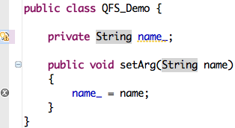
Problem Solved
Notes:
At the end the problem is fixed, however it took a couple of minutes to change one letter with IDE support, which is ironic.
And as you can see, the IDE provides me instant information about the current compilation errors without even saving the file. The red squiggles are gone and the red error marker on the left is grayed out indicating that when I save the file, it will be gone. At the top line, now there is a yellow squiggly indicating a warning, since that variable is never read. IDE provides this information due to a technique called instant compilation. Eclipse, in the background, continuously tries to compile and build your active project. This way you are warned immediately as you introduce an error. And this is great.

Slide 36
Global Best Proposals
Global best proposal
Offered at some other place
Can fix the error that the user invoked QF on
As good as the local best proposal
[Muşlu 2012]
Notes:
To quickly summarize, GBPs are
… Read the three bullet points.
And the idea of improving recommendation engines by considering the global implications of the recommendations will be presented as a short paper in the upcoming ICSE.

Slide 37
Related Work
Improving existing recommendations
Code completion based on historical usage [Robbes et al. 2008]
Eclipse: Auto-complete based on historical usage & data mining [Bruch et al. 2009]
QFS computes consequences based on precise information
IntelliSense: Finding API call chains using partial types [Perelman et al. 2012]
QFS analyzes existing recommendations
Defining new recommendations [Castro-Herrera et al. 2009] [Xiang et al. 2008]
QFS is orthogonal to these new recommendations
Speculative Analysis [Brun et al. 2010]
Crystal & proactive conflict detection [Brun et al. 2010, 2011]
QFS requires fine-grained speculative analysis
Notes:
The first research related to QFS is defining new recommendations Speculative analysis and QFS does not care what a recommendation does as long as it will create a new program that can be analyzed. Thus, QFS is orthogonal to the new recommendations, specifically Quick Fixes meaning that it will start using them in the analysis without any modification.
The second related research is improving existing recommendations. For this, Robbes made a simulation experiment over a real development history using 8 different code-completion techniques and showed that code completion based on historical usage works the best. Later Bruch applied a similar technique to Eclipse auto-complete where he showed that auto-complete can be improved using historical data and data mining.
QFS is different from these methods because these methods improve recommendations based on some heuristics whereas we try to improve recommendations by providing consequences of the recommendations based on precise information.
For improving existing recommendations, Daniel also showed that IntelliSense’s auto complete can be improved by using partial types to find API call chains. QFS is different from this work in the sense that it does not create new recommendations but only analyzes the existing recommendations and gives more information with them.
Finally, QFS is built on speculative analysis, the idea to explore possible future states of a program to give developer more information, which was introduced by Yuriy on 2010. In the same year, Yuriy also built Crystal, a proactive conflict detection tool and the next year, he showed that speculative analysis can be used to increase developer awareness and reduce merge conflicts (or at least their severity) for collaborative development.
QFS is different because obviously it is an application of speculative analysis on another domain, however also because due to the way recommendations are used as an ad-hoc basis, it requires fine-grained speculative analysis.
I need a clear text (written and memorized) for this section.

Slide 38
IDE Recommendations
Aim to increase developer speed & confidence
Are widely used by developers [Murphy et al. 2006]
Notes:
Let’s start with the IDE recommendations. In this example, we have … (Instead of telling where they are, just point them)
IDE recommendations are nice because they automate …
Mention here upfront that you will be focusing on Quick Fix for the remaining part of the talk.
Gail Murphy (et al.)

Slide 39
Refactoring Fails!
Notes:
I get a warning which says [read the warning]. Now, I am confused: the warning does not help much since I don’t really know what ‘may not be accurate’ means. However, it at least tells me the reason of failure, the compilation errors.
So, I decide to go back and resolve the compilation errors and Eclipse suggests me to use Quick Fix.

Slide 40
Speculative Analysis
java projects
apply a QF
apply a QF
a java project
compile & retrieve
compilation errors
# of remaining compilation errors for each proposal
Notes:
With speculative analysis, we take developer’s current program, create multiple copies and on each copy apply an action that is likely to happen in the future. Then, we analyze these future states to provide feedback to the developer so that he can do better choices now.
The idea behind the speculative analysis is to explore possible future states of the program that the developer is working on to provide extra feedback to the developer.
For Eclipse QF, we have a Java project that the developer is working on. We create multiple copies of that project and apply one QF proposal to each to create possible future versions. Then, we build and retrieve the compilation errors on these future versions. Finally, if the developer invokes QF, we also provide the number of remaining compilation errors to the developer so that he can make a more informed and faster decision that would affect the current program.
Finally, the whole process is repeated as a circle as the image implies.

Slide 41
Controlled Experiment
RQ1: Does QFS increase developer speed?
RQ2: Does QFS change developer behavior?
24 projects with compilation errors
2 task groups (T₁ and T₂)
Generated from real projects (case study participants)
Learning & tool bias: 4 different blocks:
QF-T₁, QFS-T₂
QFS-T₁, QF-T₂
QF-T₂, QFS-T₁
QFS-T₂, QF-T₁
Notes:
We wanted to see if the developers can resolve compilation errors faster or better with QFS. So we created 24 projects with compilation errors and broke them into two groups: alpha and beta.

Slide 42
Case Study
How do developers use Quick Fix?
~1 year, over 1000 QF invocations
QFS logged information about QF invocations
Proposals offered by Eclipse
Whether the user selected a proposal or not
The proposal selected by the user, if any

Slide 43
Measurements
Completion time for each 12 tasks (group)
Average time to complete or cancel an invocation
First, second, and [global] best proposal selection rates
# of undo invocations on proposals
Notes:
RQ 2: Does QFS increase developer confidence?
Can I rephrase the remaining 3 bullet points so that it says that developers are not really working differently with QFS, however gain speed due to the extra information?

Slide 44
Future Work
More speculation
Keep applying proposals until all errors are resolved or no more proposals are present
Deeper analysis
Run tests, apply VC operations, etc. on future programs
Notes:
There are two possible extensions for QFS. We can do more speculation: at this moment we only apply one proposal to create the possible future states, however in theory …
Result of more speculation: We can offer chain of proposals that would resolve all compilation errors in the project.
Or we can do deeper analysis. Instead of just building and getting the remaining number of compilation errors, we could …
Result of more analysis: We can break ties when the number of remaining compilation errors are the same and we can provide more consequences to the developer.
Mention that you might also want to figure out why developers do some of the actions we have seen?

Slide 45
Related Work
Improving existing recommendations
Code completion based on historical usage [Robbes et al. 2008]
Eclipse: Auto-complete based on historical usage & data mining [Bruch et al. 2009]
QFS computes consequences based on precise information
IntelliSense: Finding API call chains using partial types [Perelman et al. 2012]
QFS analyzes existing recommendations
Defining new recommendations [Castro-Herrera et al. 2009] [Xiang et al. 2008]
QFS is orthogonal to these new recommendations
Notes:
The first research related to QFS is defining new recommendations Speculative analysis and QFS does not care what a recommendation does as long as it will create a new program that can be analyzed. Thus, QFS is orthogonal to the new recommendations, specifically Quick Fixes meaning that it will start using them in the analysis without any modification.
The second related research is improving existing recommendations. For this, Robbes made a simulation experiment over a real development history using 8 different code-completion techniques and showed that code completion based on historical usage works the best. Later Bruch applied a similar technique to Eclipse auto-complete where he showed that auto-complete can be improved using historical data and data mining.
QFS is different from these methods because these methods improve recommendations based on some heuristics whereas we try to improve recommendations by providing consequences of the recommendations based on precise information.
For improving existing recommendations, Daniel also showed that IntelliSense’s auto complete can be improved by using partial types to find API call chains. QFS is different from this work in the sense that it does not create new recommendations but only analyzes the existing recommendations and gives more information with them.
Finally, QFS is built on speculative analysis, the idea to explore possible future states of a program to give developer more information, which was introduced by Yuriy on 2010. In the same year, Yuriy also built Crystal, a proactive conflict detection tool and the next year, he showed that speculative analysis can be used to increase developer awareness and reduce merge conflicts (or at least their severity) for collaborative development.
QFS is different because obviously it is an application of speculative analysis on another domain, however also because due to the way recommendations are used as an ad-hoc basis, it requires fine-grained speculative analysis.
I need a clear text (written and memorized) for this section.

Slide 46
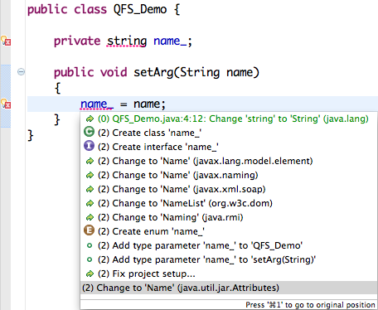
Demo
Notes:
And now, I would like to give a demo to you.
Rough plan for the demo:
I will start coding the well known unresolvable type example. This shouldn’t take much time to code and I want people to get a feel of QFS doing speculative analysis on the background in real time.
After introducing the first compilation error, I will invoke QF and show them that ‘Change to String’ is offered. But, I will not select it.
After introducing the second compilation error, I will invoke QF at the second compilation error location and I will show them that ‘Change to String’ is again offered as a global best proposal. I will select it this time and resolve all compilation errors.
I also plan a second part to show a more complex example. This time there will be one project (already implemented) with two compilation errors in different files (and also packages). The first compilation error I invoke QF will again be a dependent error (probably Exception Handling example) so I will again quickly fix both errors without even seeing the actual place.
If I have time and I can complete the implementation for this, I plan a third example where the dependent compilation error is this time on a different project. This will show that QFS can figure out the dependent projects in the build path, also speculate on those projects just in case the problem reside there.
All in all, I plan to have the demo between 5-10 minutes.

Slide 47
Evaluation
How do developers use Quick Fix?
Case study with 6 participants
Does QFS increase developer speed?
Controlled experiment with 20 grad students
Notes:
For evaluation we have done two studies: a case study with 6 participants (where 3 of them were also the authors) and a controlled experiment with 20 grad students.
Why you did this? Why I have two studies.

Slide 48
Problem with IDE Recommendations
IDEs provide little or no information about the consequences of their recommendations!
Developers must figure out these consequences, which is not trivial
Computing and showing the consequences to the developers can increase their productivity
Notes:
Throughout the example, I have shown you that IDEs provide little or …
However IDEs cannot give the same instant feedback for the recommendations they provide yet since the developer haven’t chosen them yet. It is still the developer’s responsibility to figure out the consequences (i.e., outcomes) of applying a refactoring or a proposal. And in general, this is not as easy as seen in this example.
For the remaining of the talk, I will be talking about a technique called speculative analysis that aims to remove this burden. My talk will specifically focus on an implementation of a speculative analysis on Eclipse Quick Fix to provide almost instant feedback about the consequences of Quick Fix proposals.

Slide 49
Case Study Results
Observation 1: > 90% of the time, the developers select one of the top three proposals
Reordering might be important
Eclipse might do a good job using heuristics
Observation 2: out of 50+ proposals, developers favor six of them > 80% of the time
Frequent & simple actions where the developers are sure that the fix is correct
e.g., importing a type, exception propagation, and creating method stub
Notes:
Second observation is not very clear. Make sure they are here!
Mention that the first observation is when the developers pick up a proposal.
Mention that it is interesting why developers act like this and it is a good topic for future work.

Slide 50
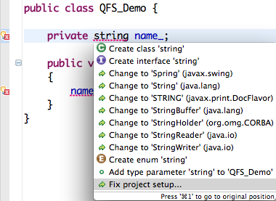
Running Speculative Analysis
Notes:
Now, I’d like to show you how speculative analysis computes remaining compilation errors. In this example, I will focus on the top four proposals. To apply them, I need 4 copies of the same code.

Slide 51
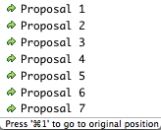
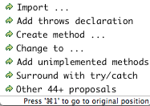
Case Study Results
> 90% of the time, the developers select one of the top three proposals (QF & QFS)
Reordering might be important
Eclipse might do a good job using heuristics
Selected 80% of the time
Frequent & simple actions where the developers are sure that the fix is correct
Notes:
Second observation is not very clear. Make sure they are here!
Mention that the first observation is when the developers pick up a proposal.
Mention that it is interesting why developers act like this and it is a good topic for future work.

Slide 52
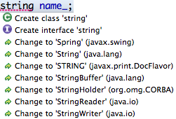
Case Study Results
> 90% of the time, the developers select one of the top three proposals (QF & QFS)
Reordering might be important
Eclipse might do a good job using heuristics
Selected 80% of the time
Frequent & simple actions where the developers are sure that the fix is correct
Notes:
Second observation is not very clear. Make sure they are here!
Mention that the first observation is when the developers pick up a proposal.
Mention that it is interesting why developers act like this and it is a good topic for future work.

Slide 53
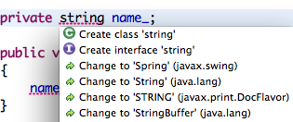
Case Study Results
> 90% of the time,
the developers select one of the top three proposals (QF & QFS)
Reordering might be important
Eclipse might do a good job using heuristics
6 out of 50+ actions are selected
80% of the time
Frequent & simple actions where the developers are sure that the fix is correct
Notes:
Second observation is not very clear. Make sure they are here!
Mention that the first observation is when the developers pick up a proposal.
Mention that it is interesting why developers act like this and it is a good topic for future work.

Slide 54
Case Study Results
5 out of 10 categories of proposals are selected 90% of the time
6 out of 50+ proposals are selected
80% of the time
Frequent & simple fixes whose correctness can quickly be verified by the developers
Can be used as heuristics to prioritize proposals in the dialog
Notes:
Second observation is not very clear. Make sure they are here!
Mention that the first observation is when the developers pick up a proposal.
Mention that it is interesting why developers act like this and it is a good topic for future work.

Slide 55
Controlled Experiment Results
Measurement | Absolute Change (QFS - QF) | Relative Change | Statistical Significance
Time to Complete the Task | -3 minutes | -12% | N [p=0.11]
Best Proposal Selection Rate | 0.14 | 19% | Y [p=10⁻⁸]
Time to Complete Invocation | 0.8 seconds | 22% | Y [p=0.004]
When using QFS, global best proposal selection rate: 75%
Measurement | Value (same for QF and QFS)
Invocation Completion Rate | 57%
1st, 2nd, 3rd Proposal Selection Rates | 75%, 19%, 1%
Average Time to Cancel Invocation | 7.4 s
Undo Rate | 15%
QFS did not affect the way users interacted with QF Dialog
Users understood the code faster and selected better fixes
Notes:
For all measurements, we compared QFS and QF.
For all quantities that are measured and for each task group, we applied a Mann-Whitney U test to see the effect of QFS. I will mostly focus on the quantities that we see statistical significance, which are shown in blue.
We applied a Mann-Whitney test to calculate significance.
For the tasks that are completed in the first part of the experiment, QFS …
For the tasks that are completed in the second part of the experiment, QFS …
With QF T1 averaged 1359 seconds. The value returned from Mann-Whitney U test was 403 seconds. % improvement = 403/1359*100= 29.6541

Slide 56
Using IDE Recommendations
Compilation error 1
Compilation error 2
Notes:
Say up front that instant feedback is important (i.e., squigglies) and cannot be given for the recommendations. QF and auto-complete are also instant feedbacks, however they might be broken (as I will show in the future) and we want to take this forward by giving also the consequences of each recommendation as instant feedback.
I want to show you the problem with IDE recommendations on a simple example.
In this example, we can see that there are two compilation errors represented by red squigglies and markers. We see this information thanks to a technology called instant compilation. In the background, Eclipse continuously tries to build our program and whenever there are compilation errors, it shows them to us. This is very helpful to the developer as he can immediately realize that he introduced an error and starts to fix it.
I am a developer and I have the following simple code. I realize that the method ‘setArg’ is named incorrectly and I decide to change its name to ‘setName’ to make changes consistently all over the code, I decide to apply a rename refactoring. For this example, I am writing in Java and using Eclipse. So Eclipse suggest me to use its refactoring engine.
I say okay, and try to apply a rename refactoring, however …

Slide 57
Quick Fix Failure
Notes:
I go to the compilation error inside the method and invoke Quick Fix, Eclipse gives me the following suggestions (also known as proposals). In theory, each of these suggestions should resolve the compilation error on that line, however [read some of them] as you can see, none of them actually resolves anything.
This is due to the fact that this compilation error is dependent on the other compilation error and I should be resolving the other error, which resolves this one, too.
After spending some time, trying to understand what each proposal does, I give up and decide to invoke QF on the other compilation error.

Slide 58
Quick Fix Success?
Notes:
This time the following proposals are given. I start reading them [read some]. If I am patient enough, I find the correct fix as the 4th proposal and select it.

Slide 59
Case Study
How do developers use Quick Fix?
~1 year, over 1000 QF invocations

Slide 60
Controlled Experiment Results
Measurement | Absolute Change (QFS - QF) | Relative Change
Time to Complete the Task | -3 minutes | -12%
Best Proposal Selection Rate | 0.14 | 19%
Time to Complete Invocation | 0.8 seconds | 22%
When using QFS, global best proposal selection rate: 75%
Users invoked QF equally when using QFS or not using it
Users spent more time examining QFS than QF
Overall bug-removal time decreased by 12%
➦ Developers might have gained more relevant information ➦ while using QFS
Notes:
Don’t mention both absolute and relative changes, just mention one of them.
For all measurements, we compared QFS and QF.
For all quantities that are measured and for each task group, we applied a Mann-Whitney U test to see the effect of QFS. I will mostly focus on the quantities that we see statistical significance, which are shown in blue.
We applied a Mann-Whitney test to calculate significance.
For the tasks that are completed in the first part of the experiment, QFS …
For the tasks that are completed in the second part of the experiment, QFS …
With QF T1 averaged 1359 seconds. The value returned from Mann-Whitney U test was 403 seconds. % improvement = 403/1359*100= 29.6541

Slide 61
Case Study
How do developers use Quick Fix?
Instrumented QFS to log QF invocations
whether a proposal is selected or not
selected proposal
1000 QF invocations

Slide 62
Case Study Results
5 out of 10 categories of proposals
are selected 90% of the time
6 out of 65 proposals
are selected 80% of the time
➦ Can be used for secondary prioritization of the proposals
Notes:
Mike: After saying the first part (categories), don’t dwell, continue.
Second observation is not very clear. Make sure they are here!
Mention that the first observation is when the developers pick up a proposal.
Mention that it is interesting why developers act like this and it is a good topic for future work.

